Slide 1

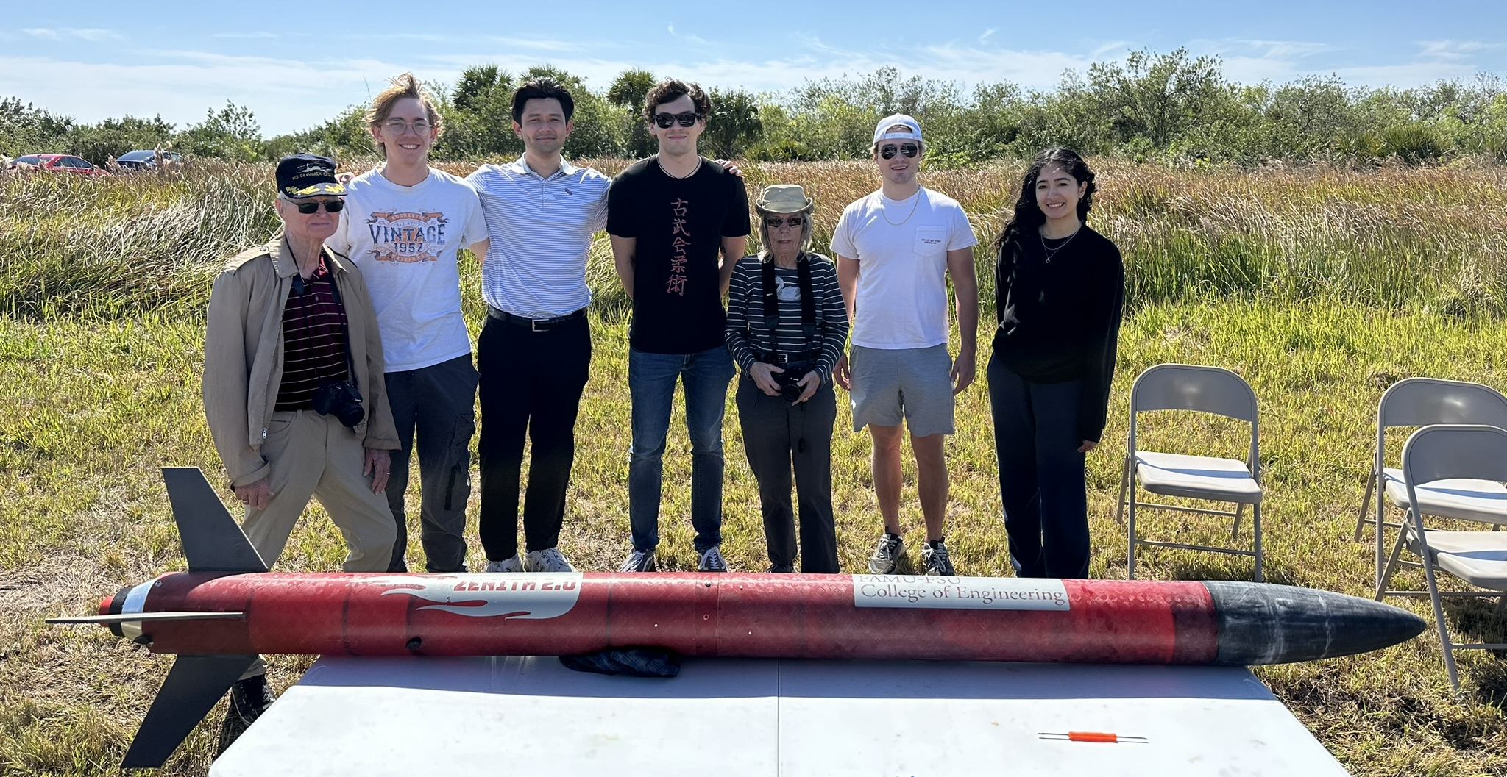
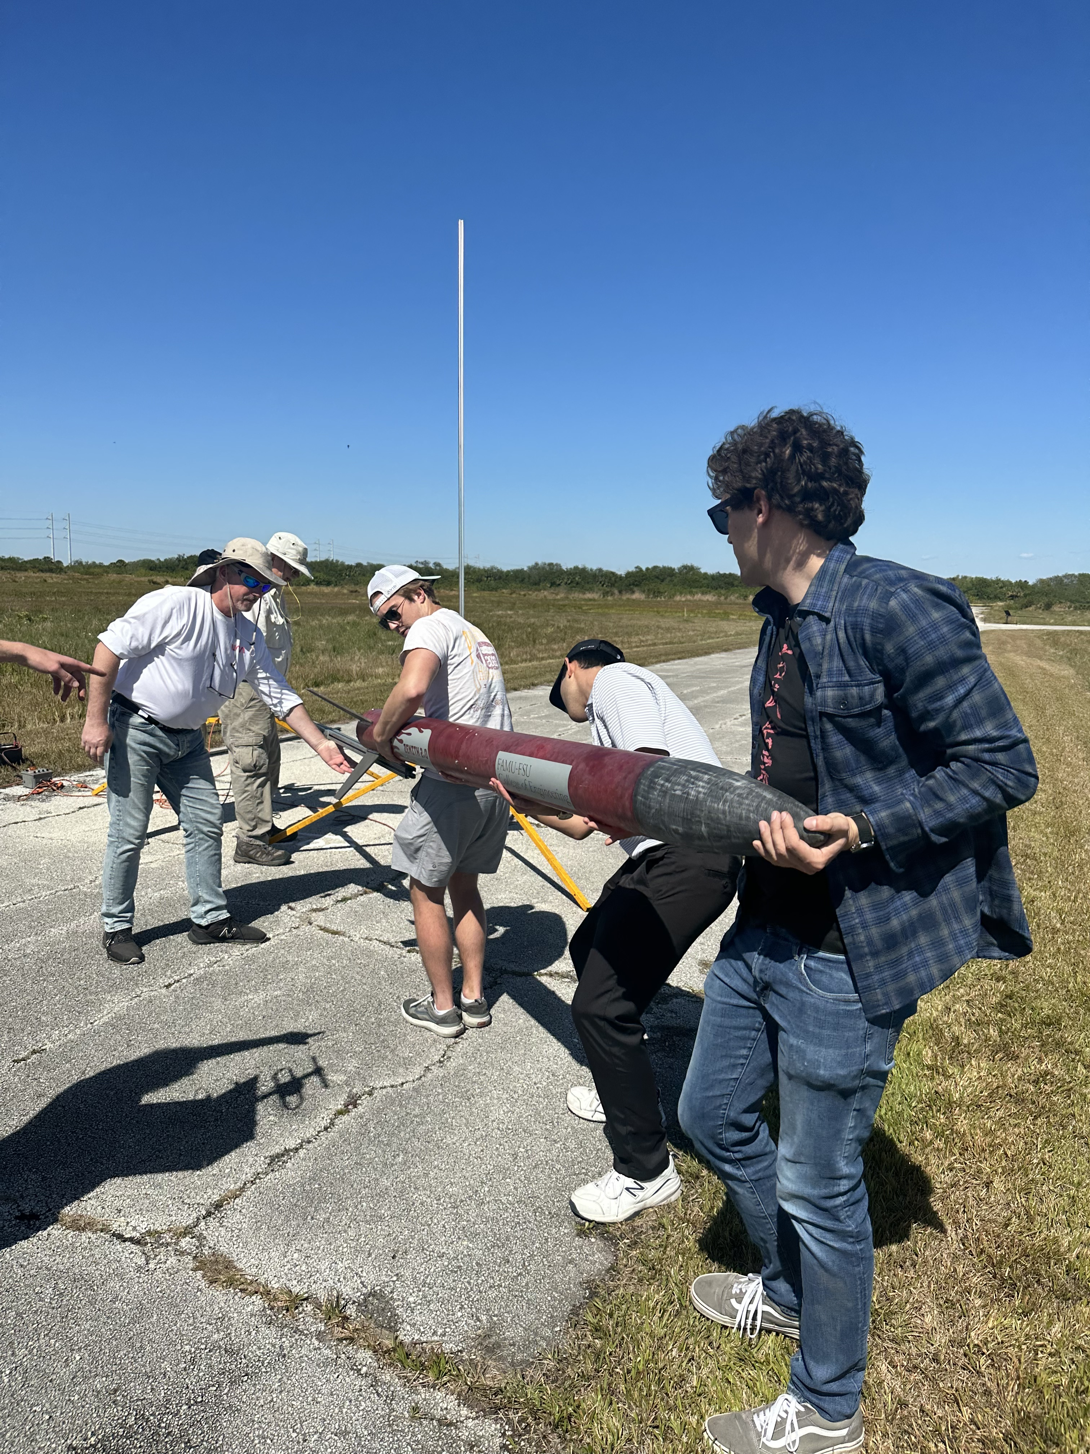
Full-Scale Test Flight 2
Nicholas Hux
Launched again on February 24th.
  Added custom vinyl decals.
  Pressure ports
  Extra shear pin
  Accounted for weight and Cd in simulations
  Nosecone finish
Predicted flight
  Apogee: 4331-ft.
  Main Deploy: 600-ft.

Slide 2

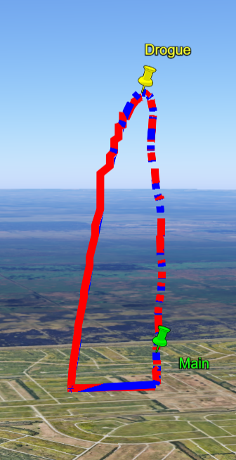
Full-Scale Test Flight 2 Launch Video
Nicholas Hux

Slide 3
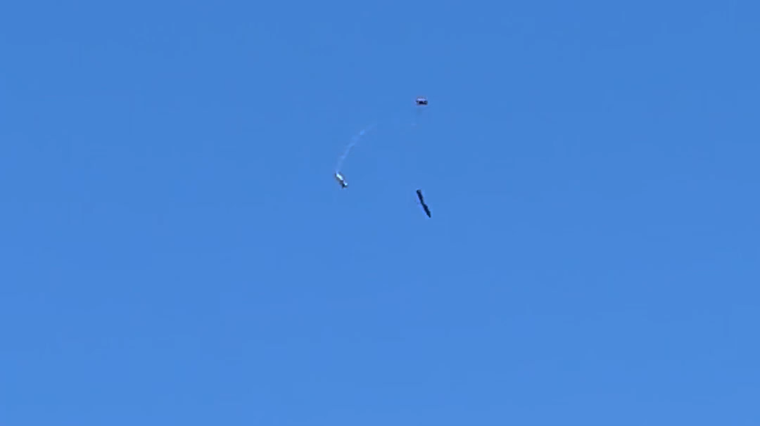
Full-Scale Test Flight 2 Recovery Video
Nicholas Hux

Slide 4
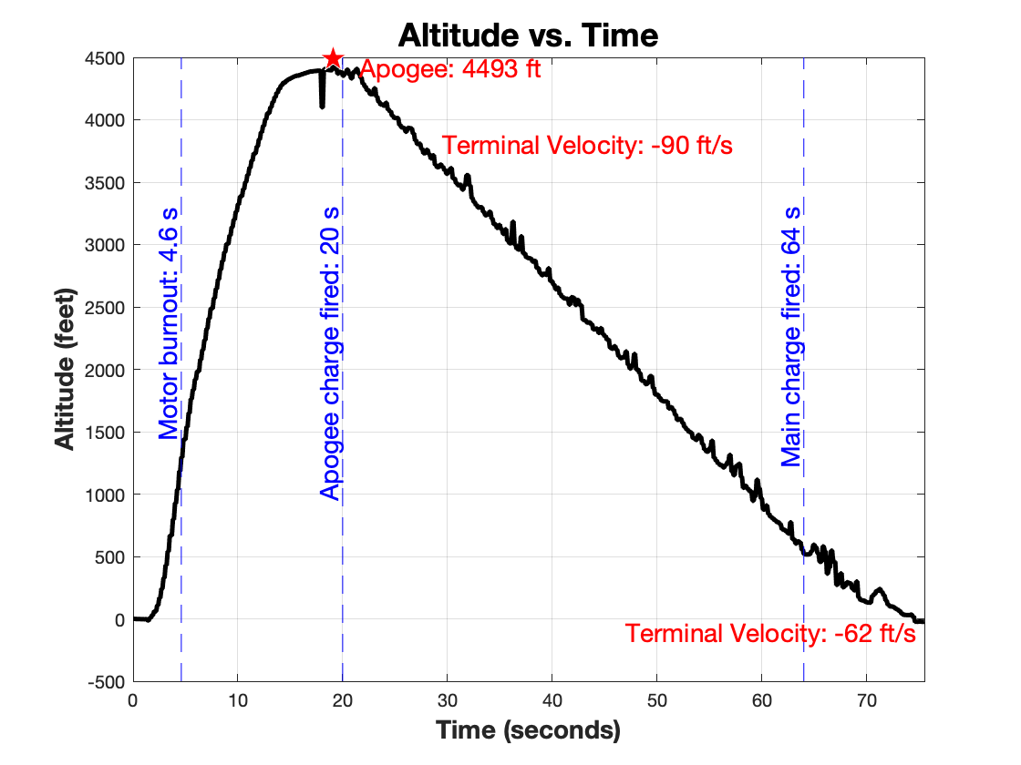
Full-Scale Test Flight 2 - Data
Nicholas Hux
Both altimeters read apogee of 4493-ft.
Separation of airframe occurred as planned.
  Changes from last flight were successful.
Notes:
Fixes worked, but a new problem arose

Slide 5
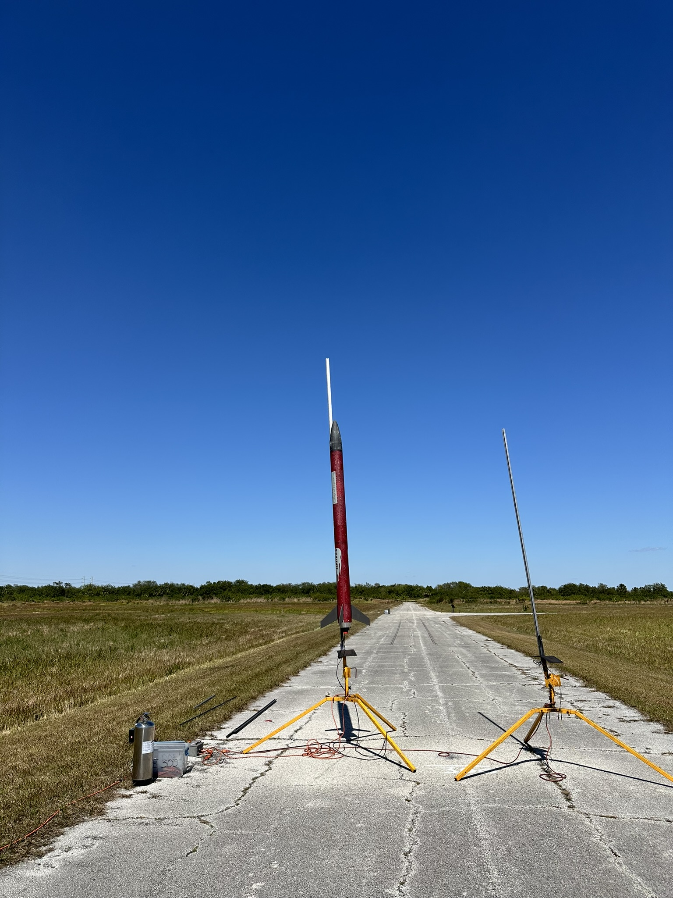
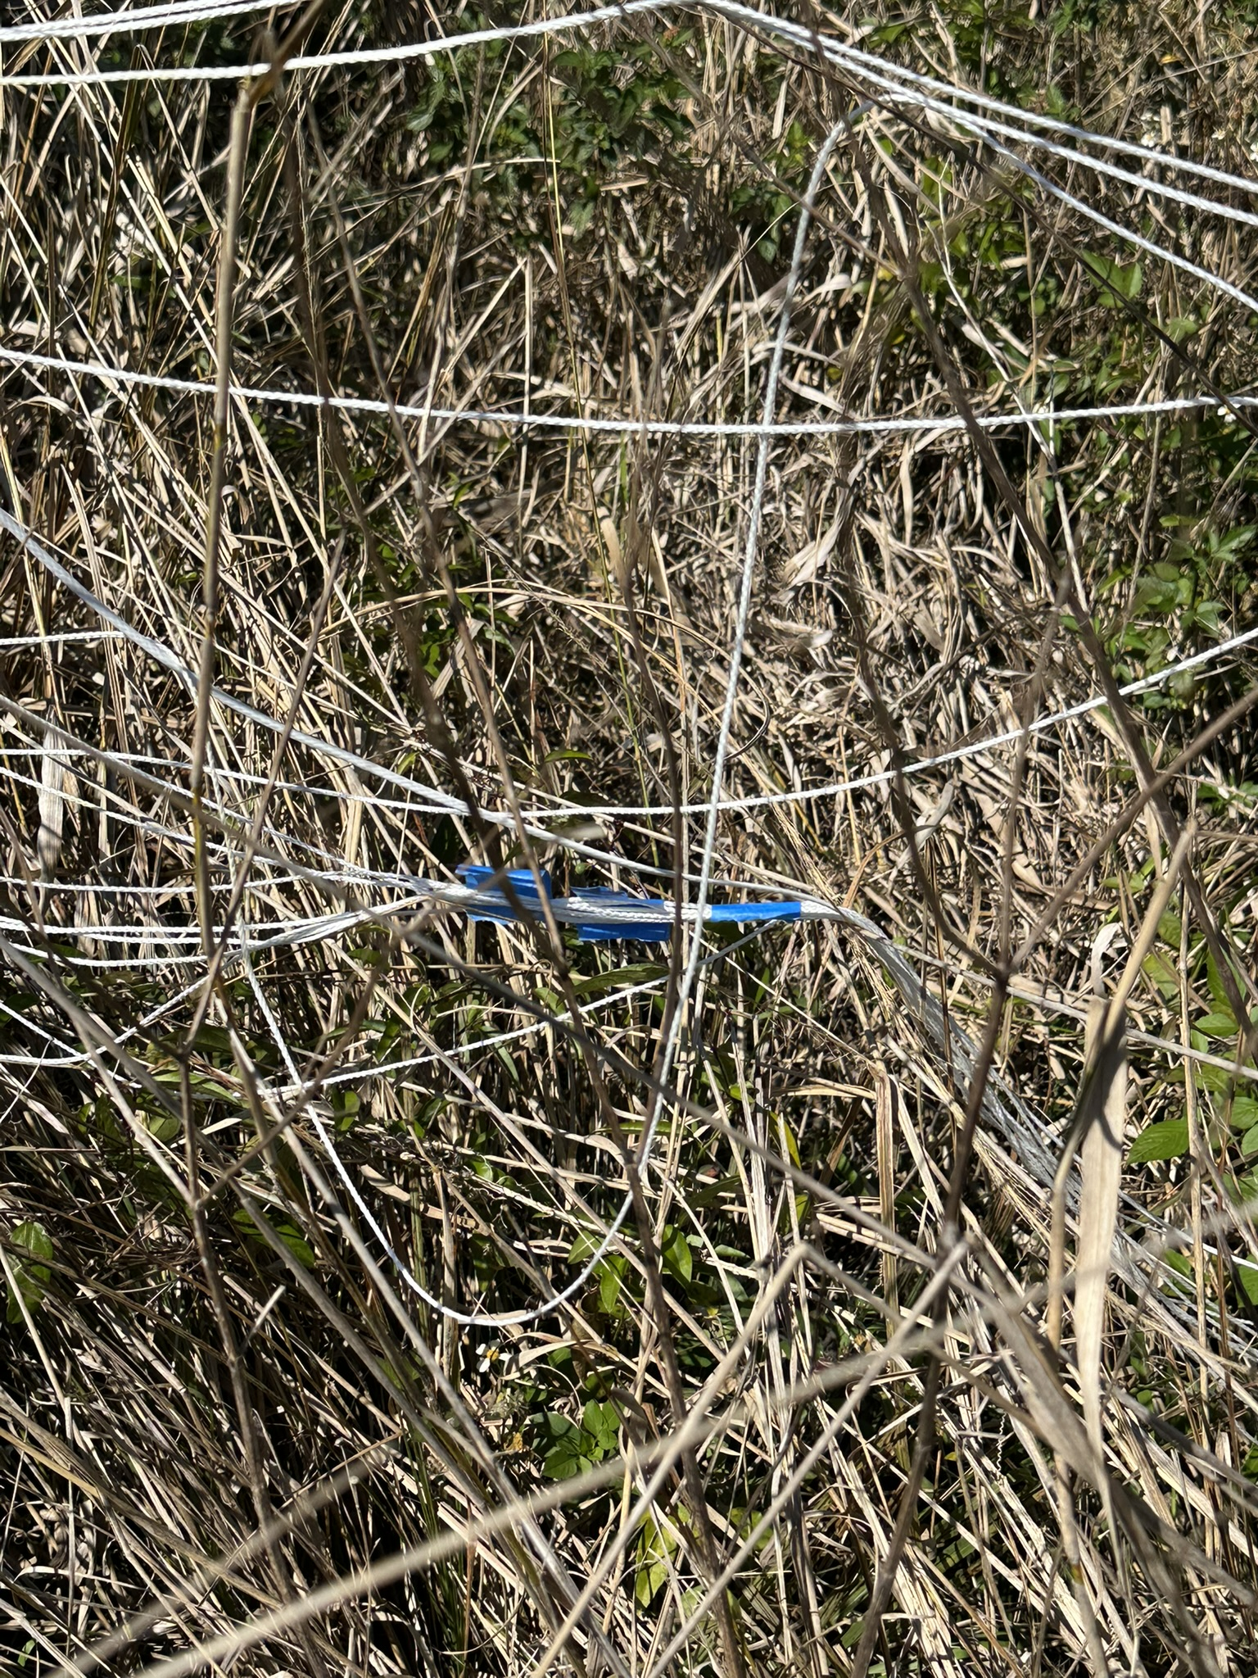
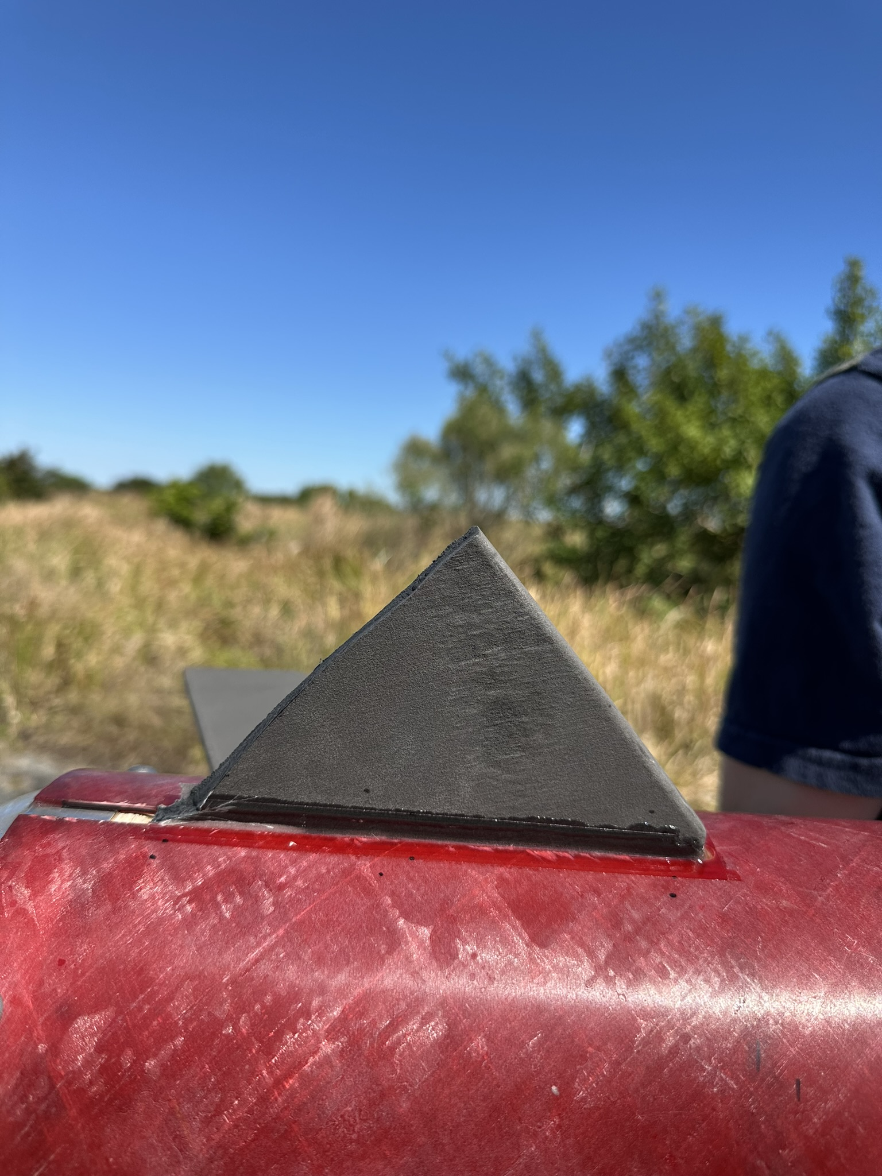
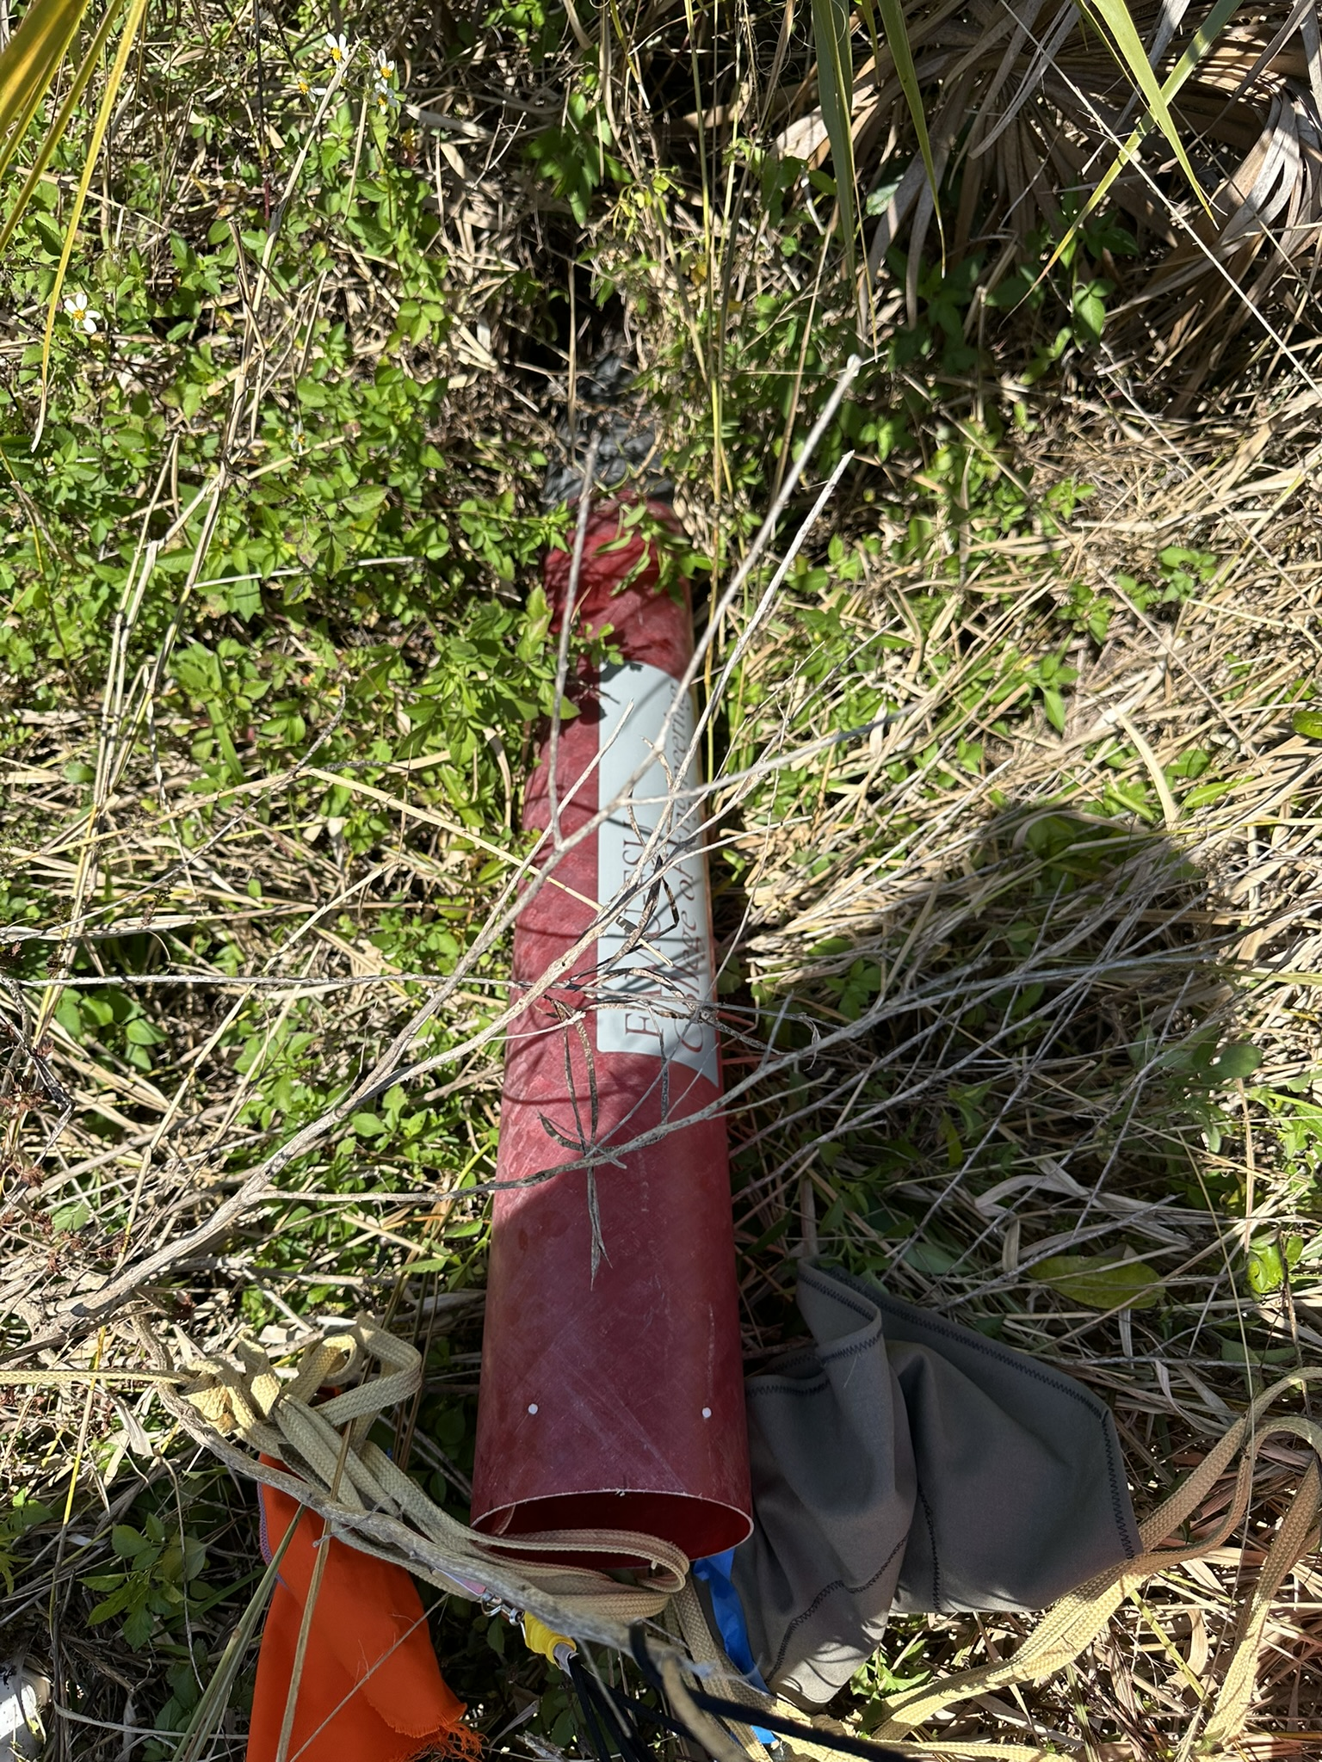
Full-Scale Test Flight 2
Nicholas Hux
Failure Analysis
  Main parachute did not fully extend.
  Fin broke due to high kinetic energy upon impact.
Failure occurred through over-taping the parachute, and collision with avionics bay

